Slide 1
Kenya Baseline Transmission Model

Slide 2
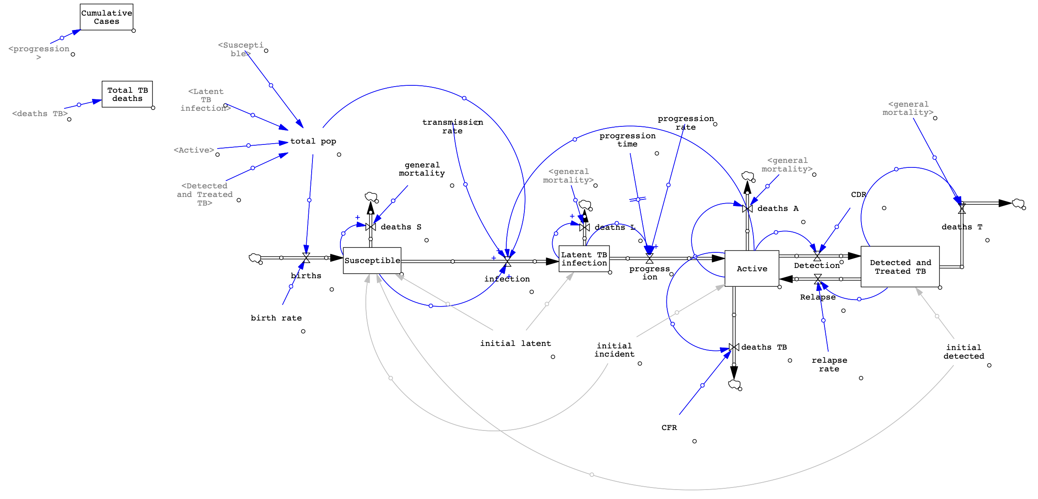
Baseline SFD

Slide 3
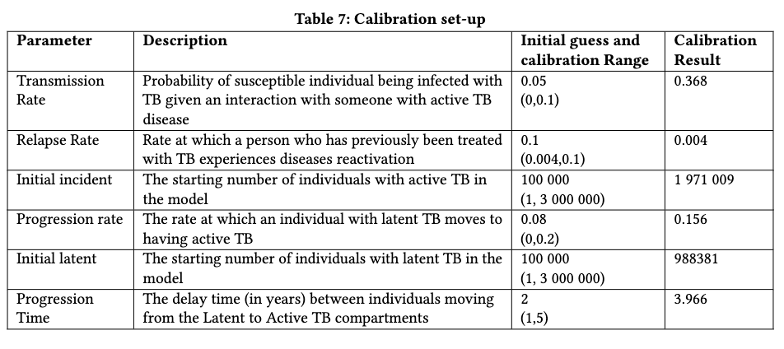
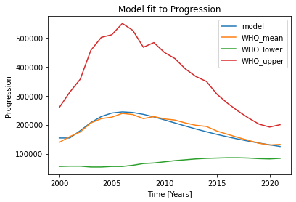
Baseline Calibration

Slide 4
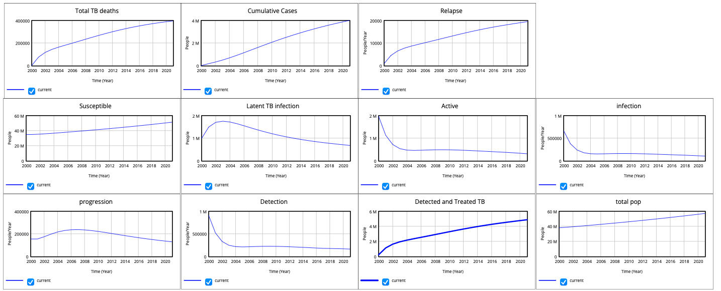
Calibrated Baseline Output

Slide 5
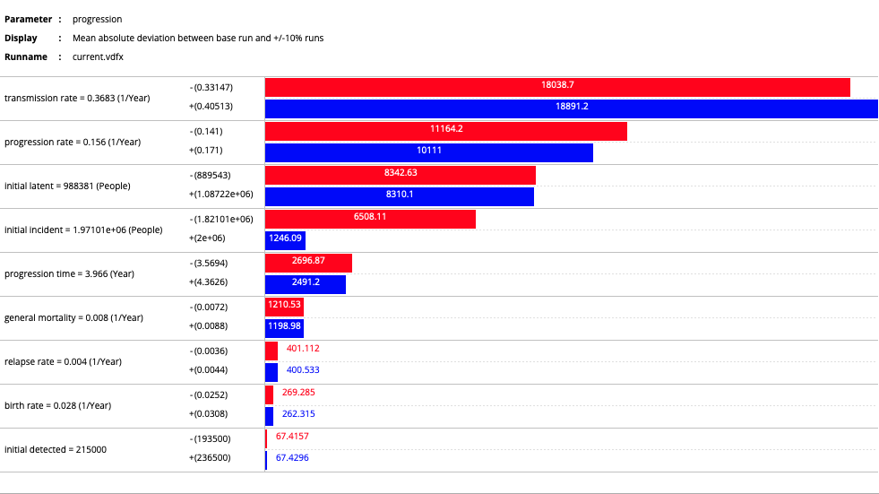
Tornado Plots: Progression

Slide 6
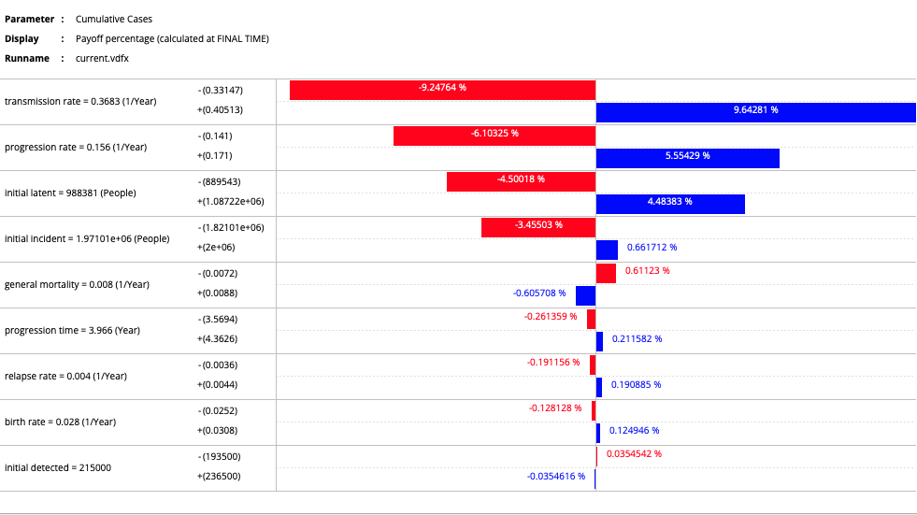
Tornado Plots: Cumulative New Cases

Slide 7
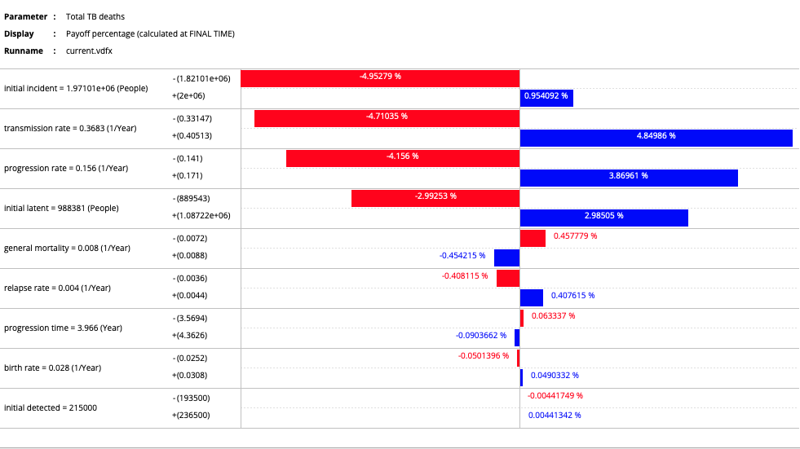
Tornado Plots: Total TB deaths

Slide 8
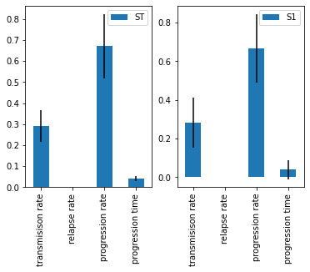
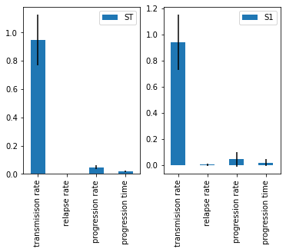
Sobel Indices: Progression
2005
2015

Slide 9
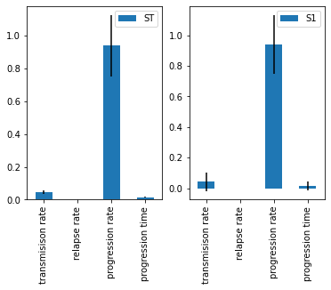
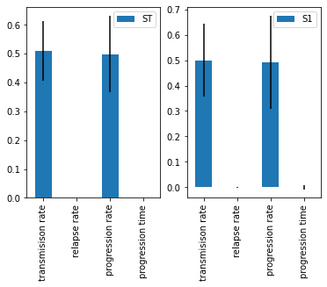
Sobel Indices: New Cases
2005
2015

Slide 10

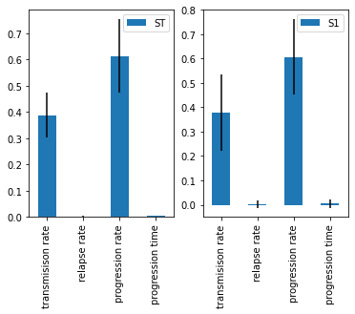
Sobel Indices: Total TB deaths
2005
2015

